Slide 1
Parallel Algorithms III
Topics: graph and sort algorithms

Slide 2
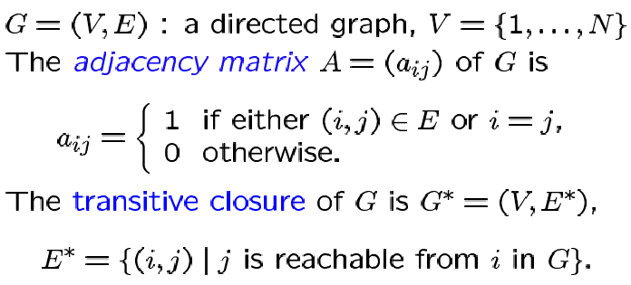
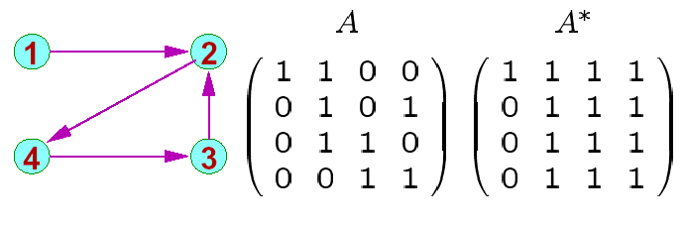
Graph Algorithms

Slide 3
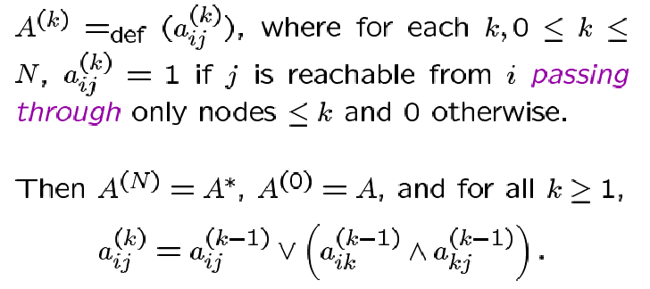
Floyd Warshall Algorithm

Slide 4
Implementation on 2d Processor Array
Row 3
Row 2
Row 1
Row 3
Row 2
Row 3
Row 1
Row 1/2
Row 1/3
Row 1
Row 2
Row 2/3
Row 2/1
Row 2
Row 3
Row 3/1
Row 3/2
Row 3
Row 1
Row 2
Row 1
Row 3
Row 2
Row 1

Slide 5
Algorithm Implementation
Diagonal elements of the processor array can broadcast
to the entire row in one time step (if this assumption is not
made, inputs will have to be staggered)
A row sifts down until it finds an empty row – it sifts down
again after all other rows have passed over it
When a row passes over the 1st row, the value of a_{i1} is
broadcast to the entire row – a_{ij} is set to 1 if a_{i1} = a_{1j} = 1
– in other words, the row is now the i^{th} row of A⁽¹⁾
By the time the k^{th} row finds its empty slot, it has already
become the k^{th} row of A^{(k-1)}

Slide 6
Algorithm Implementation
When the i^{th} row starts moving again, it travels over
rows a_{k} (k > i) and gets updated depending on
whether there is a path from i to j via vertices < k (and
including k)

Slide 7
Shortest Paths
Given a graph and edges with weights, compute the
weight of the shortest path between pairs of vertices
Can the transitive closure algorithm be applied here?

Slide 8
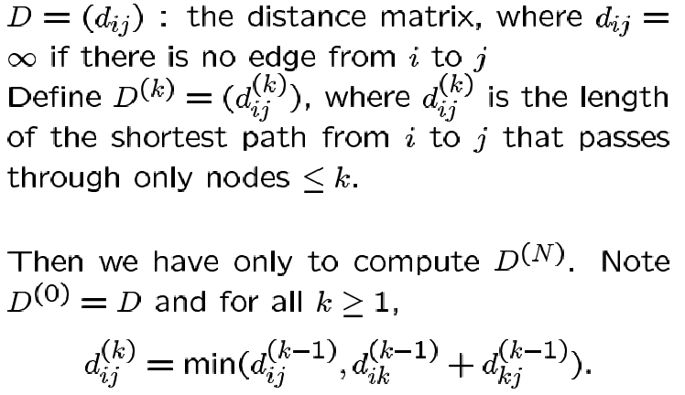
Shortest Paths Algorithm
The above equation is very similar to that in transitive closure

Slide 9
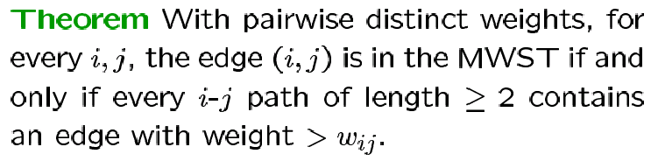
Minimum Weight Spanning Tree
Given an undirected connected graph and edges with
weights, compute the spanning tree with minimum sum
of weights
The following theorem simplifies the algorithm design:

Slide 10
Example
0.9
1
4.4
3.0
10
2
4.5
2.9
3.1
9
5.7
3
3.4
0.8
2.9
8
4
3.7
3.3
4.3
7.6
7
5
3.2
7.5
6

Slide 11
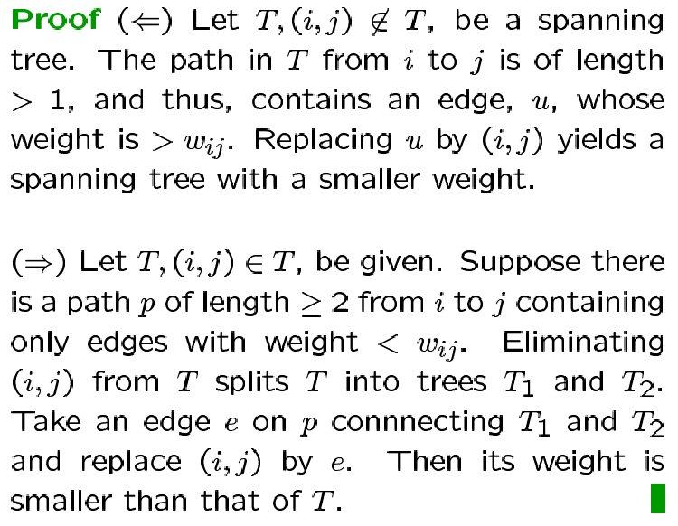
Theorem Proof

Slide 12
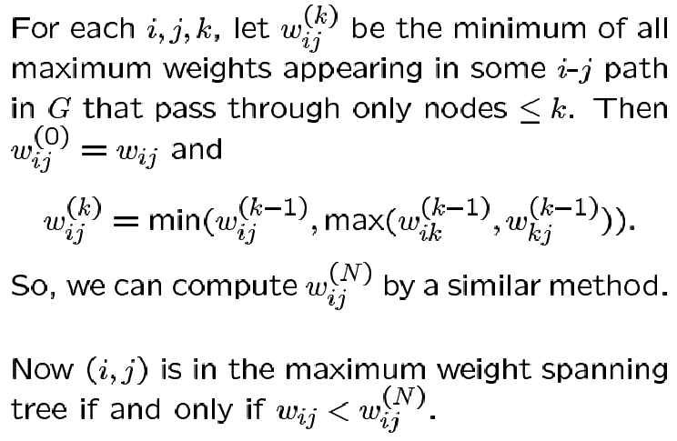
Parallel Algorithm Implementation
Employ shortest-paths algorithm again – the weight of a
path is now the heaviest edge on the path

Slide 13
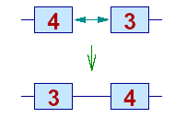
Sorting with Comparison Exchange
Earlier sort implementations assumed processors that
could compare inputs and local storage, and generate
an output in a single time step
The next algorithm assumes comparison-exchange
processors: two neighboring processors I and J (I < J)
show their numbers to each other and I keeps the
smaller number and J the larger

Slide 14
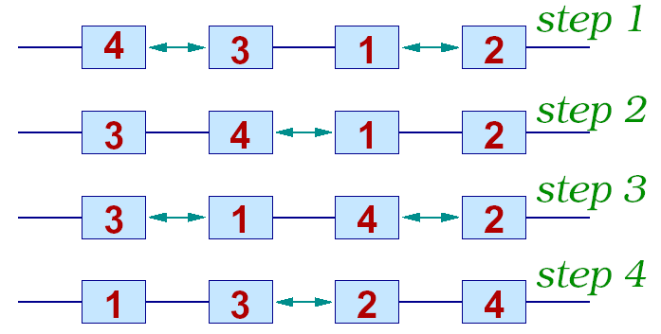
Odd-Even Sort
N numbers can be sorted on an N-cell linear array
in O(N) time: the processors alternate operations with
their neighbors

Slide 15
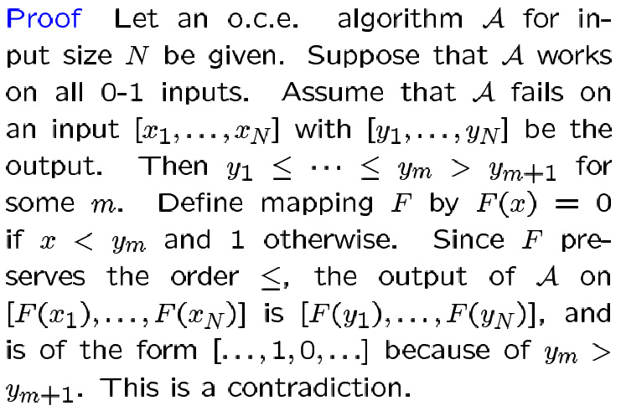
The 0-1 Sorting Lemma
If a comparison-exchange algorithm sorts input sets
consisting solely of 0’s and 1’s, then it sorts all input
sets of arbitrary values

Slide 16
Shearsort
A sorting algorithm on an N-cell square matrix that
improves execution time to O(sqrt(N) logN)
Algorithm steps:
Odd phase: sort each row with odd-even sort (all odd
rows are sorted left to right and all even
rows are sorted right to left)
Even phase: sort each column with odd-even sort
Repeat
Each odd and even phase takes O(sqrt(N)) steps – the
input is guaranteed to be sorted in O(logN) steps

Slide 17
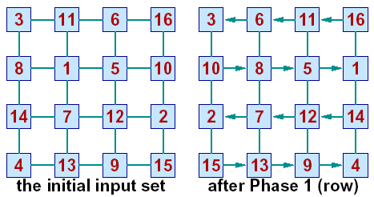
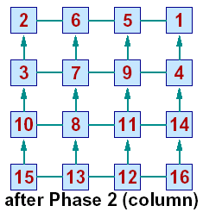
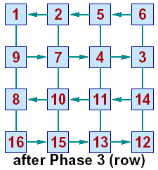
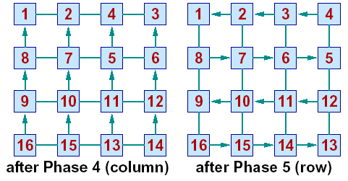
Example

Slide 18
Complexity Proof
How do we prove that the algorithm completes in O(logN)
phases? (each phase takes O(sqrt(N)) steps)
Assume input set of 0s and 1s
There are three types of rows: all 0s, all 1s, and mixed
entries – we will show that after every phase, the number
of mixed entry rows reduces by half
The column sort phase is broken into the smaller steps
below: move 0 rows to the top and 1 rows to the bottom;
the mixed rows are paired up and sorted within pairs;
repeat these small steps until the column is sorted

Slide 19
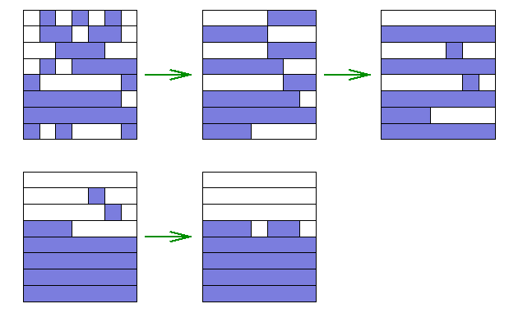
Example
The modified algorithm will behave as shown below:
white depicts 0s and blue depicts 1s

Slide 20
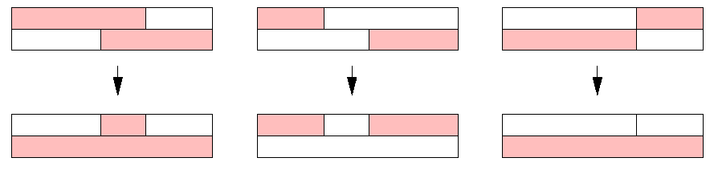
Proof
If there are N mixed rows, we are guaranteed to have
fewer than N/2 mixed rows after the first step of the
column sort (subsequent steps of the column sort may
not produce fewer mixed rows as the rows are not sorted)
Each pair of mixed rows produces at least one pure row
when sorted

Slide 21
Title
Bullet

